Slide 2

Military Based Patrol Vehicle
BY:
RATHIESH PRASAD
SAIRAM
SANJITHA

Slide 3
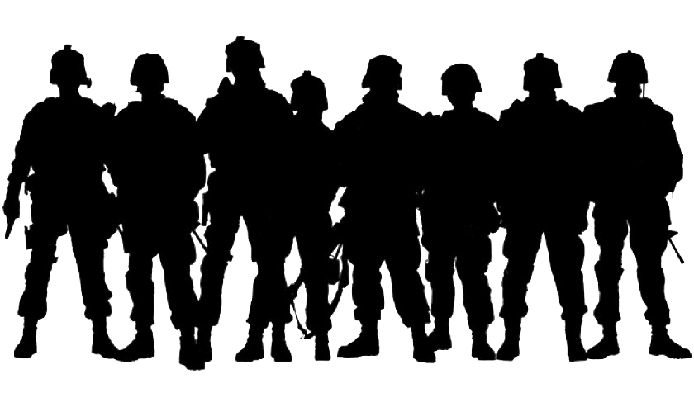
Problem Statement
For the protection of the Indian border various patrols car will be dispatched to keep an eye on the intruders.These patrol cars are often deployed in remote areas and it is difficult for the commanders to track their movements and ensure their safety.As this is a highly dangerous tasks for the troops it has been automated by using a rover

Slide 4
Abstract
Military based vehicle for the safety of soldiers.
At present the patrol vehicles are driven by the soldiers
and their lives are in risks as the intruders may attack them.
There are some existing systems for UGV’s, but those systems are remote controlled and it needs some man power.
To overcome these difficulties a fully automated rover is implemented which is used for surveillance, communication, navigation etc.

Slide 5
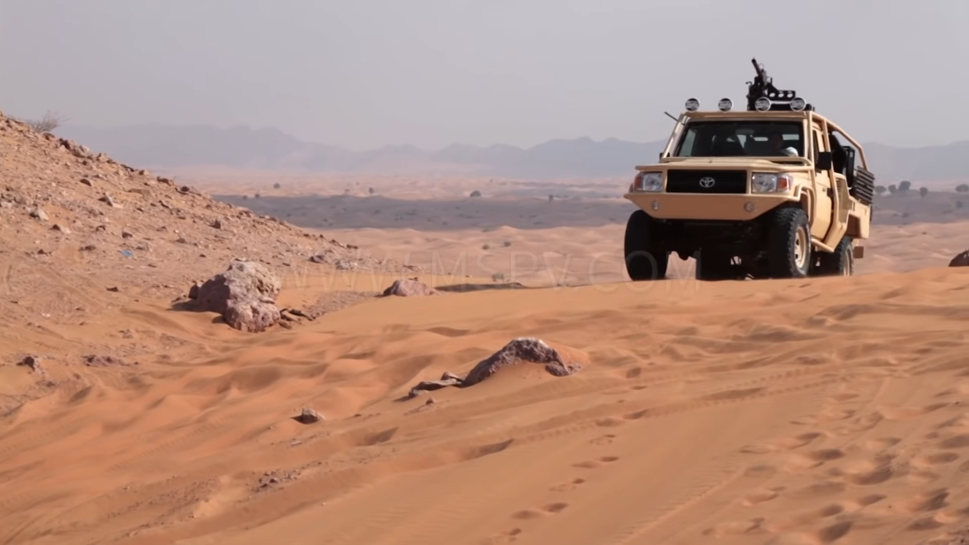
Traditional Rover

Slide 6
Components Required
Zfm60 gear motor
Components
Ultrasonic sensor
GSM Module
Arduino
L293d motor driver

Slide 7
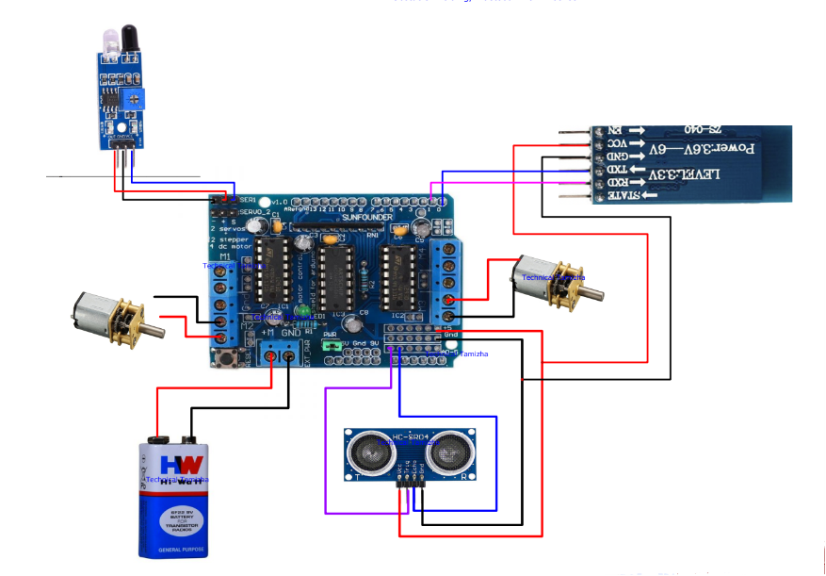
Detailed Design

Slide 8
Sample Code
void setup() {
Serial.begin(9600);
L_motor.setSpeed(200);
R_motor.setSpeed(140);
R_motor.run(RELEASE);
L_motor.run(RELEASE);
pinMode(trigPin, OUTPUT);
pinMode(echoPin, INPUT);
}
int mdistance()
{
digitalWrite(trigPin, LOW);
delayMicroseconds(2);
digitalWrite(trigPin, HIGH);
delayMicroseconds(10);
digitalWrite(trigPin, LOW);
duration = pulseIn(echoPin, HIGH);
distance= duration*0.034/2;
}
void loop() {
distancecm=mdistance();
if(distance<5){
R_motor.run(RELEASE);
L_motor.run(RELEASE);
//go backward
R_motor.run(BACKWARD);
L_motor.run(BACKWARD);
//go Right
delay(1000);
R_motor.run(FORWARD);
L_motor.run(BACKWARD);
delay(1000);
}
else{
L_motor.run(FORWARD);
R_motor.run(FORWARD);
}

Slide 9
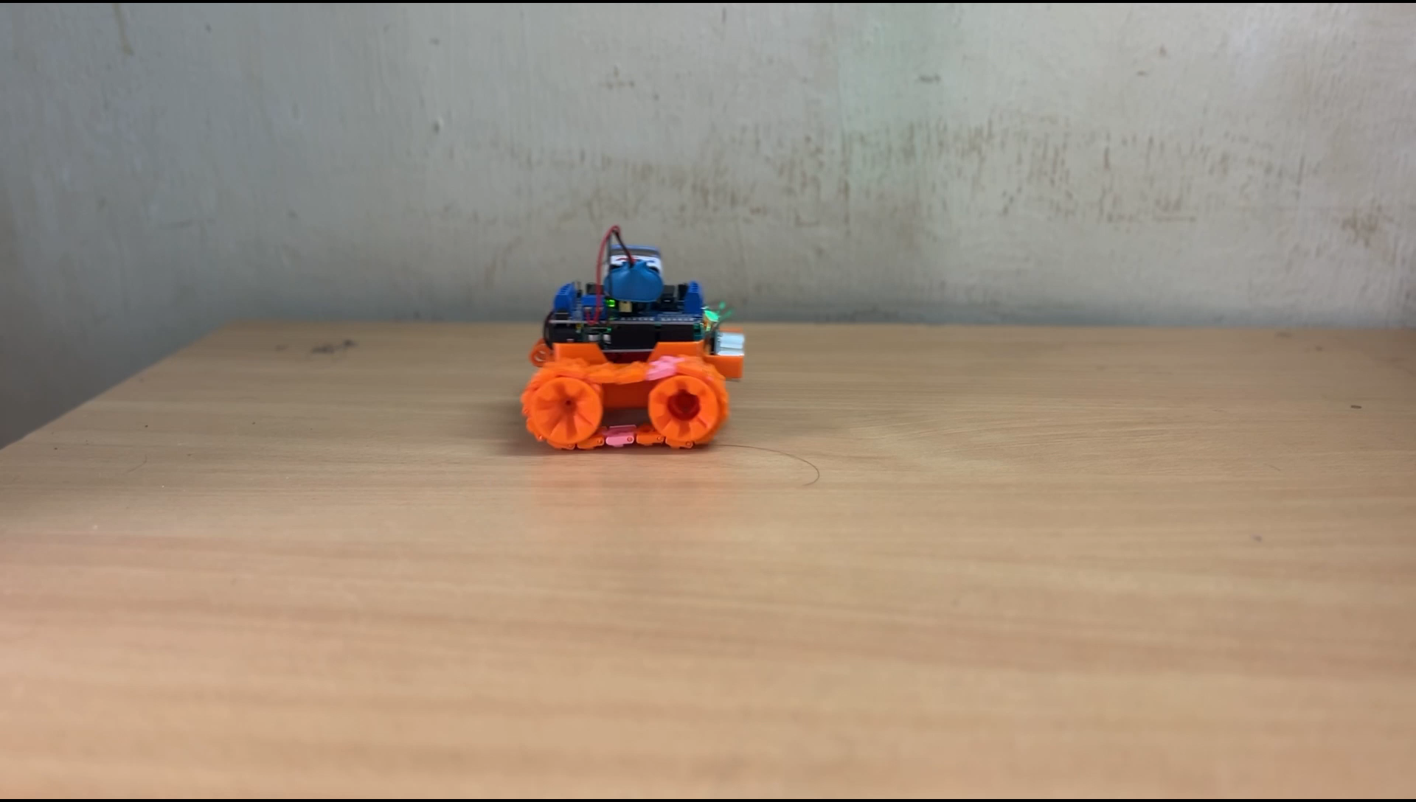
Prototype

Slide 10
LITERATURE SURVEY
SERIAL NO. | AUTHOR NAME | TITLE | TECHNIQUES/ TECHNOLOGY USED | RESULT
1. | Sainadh Jasthi | Unmanned Ground Vehicle for Military Purpose | Magnetic compass to measure the turning angles. | It is an automatic rover which uses magnetic compass for its movement.
2. | S. Mohamed Imran | UNMANNED GROUND VEHICLE FOR MILITARY ASSISTANCE | Metal detector is used to detect land mines. | Automatic rover which uses metal detector to trace a safe path for soldiers.
3. | Christian A. Andersson | The Unmanned Ground Vehicles to be used in future military operations | Lethal autonomous weapon is used. | It’s a concept where it uses weapons to attack enemies if necessary.

Slide 11
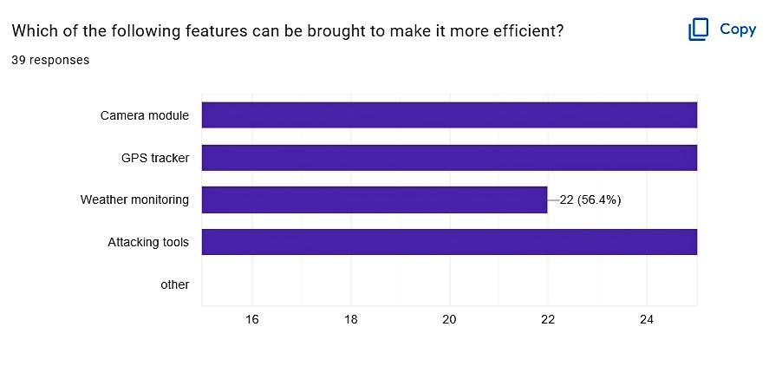
FUTURE WORK:

Slide 12
THANK YOU

